Slide 1
COVID-19 Global Forecasting
By Anil Patel and Debbie Kirchner

Slide 2
Motivation
The current COVID-19 pandemic has drastically changed people’s lives throughout the world. So far, over 3,900,000 people have been infected worldwide and over 270,000 have died from the virus. Confirmed cases have been found in every country in the world.
Predicting which countries will be hit hardest by the pandemic, how quickly people will be infected, and how many people will die, is crucial in determining which steps each country should take to combat coronavirus.
We will use past data for confirmed cases and fatalities from each country to predict future infection and death rates using a convolutional neural network.

Slide 3
Data Description
The COVID-19 Global Forecasting dataset contains a train and a test csv file.
The train dataset contains the number of confirmed cases and fatalities on each day from January 31, 2020 to March 31, 2020 for each country. Some larger countries’ data is broken into regions or states.
The test dataset contains the dates from March 19, 2020 to April 30, 2020 for each country or region so that the number of confirmed cases and fatalities can be predicted for those dates.
We also added some extra data about each country and region to the dataset that could be helpful in predicting cases and finding trends in the spreading of COVID-19.

Slide 4
Added Data
The categories that we added and our hypothesis for how it would affect the number of cases or fatalities are as follows:
Human Development Index – corresponds to how developed a country is. We expect more developed countries to have more cases.
Government Type – we expect more authoritarian governments to potentially have fewer cases, as they could more effectively enforce lockdowns.
Hospital Beds Per Capita – we expect a higher number to correlate with fewer fatalities.
Continent – we expect Asia to have the most cases, followed by Europe and North America.

Slide 5
Added Data (cont.)
The categories that we added and our hypothesis for how it would affect the number of cases or fatalities are as follows:
Population Density – we expect more densely populated countries to have more cases than less densely populated areas.
Average March Temperature – there is speculation that the virus does not spread as effectively in heat, so a higher March temperature might correlate with fewer cases.
Lockdown (yes/no) – we expect countries that enforce a lockdown to have fewer cases.
Population – larger populations would have larger numbers of cases and fatalities. Used to scale the data to account for population. (Unimplemented)

Slide 6
Solutions
LSTM (Long Short Term Memory) Model
CNN (Convolutional Neural Network) Model

Slide 7
First Solution (LSTM) – Increment 2
Pros
Cons
Special kind of RNN (Recurrent Neural Network).
Capable of learning order dependence in sequence prediction problems aka meant for predicting sequences like the goal for this project.
Quite complex area of deep learning.
Becomes more complex to use properly with the large amount of different sequences and needing unique predictions for each.
Even more complex to use when combining it with non-sequential data that effects each sequences.

Slide 8
First Solution (LSTM) – Increment 2
Conclusion:
Though this model was the first and most obvious choice for our project, it became too complex of a concept to use effectively. That complexity problem largely expands knowing we wanted to include non-sequential data as well. By Increment 2, we were still having problems with training the model on only the sequential data. So for the sake of time and where we wanted to be, we moved to a different and simpler approach.
Increment 2 Wiki: https://github.com/aniljp97/DeepLearning/wiki/Final-Project-Increment-2

Slide 9
Second Solution (CNN) – Increment 3
Pros
Cons
Flexible to training on many multivariate data.
Easy to apply for many sequences, multiple parallel inputs, and multi-step output.
Makes combining sequential and non-sequential easy.
Capable on categorical data but not as capable for the sequential data. In other words, it doesn’t separate the non-sequential and sequential data and treats both the same categorically.
No order dependence for the sequential data.

Slide 10
Second Solution (CNN) – Increment 3
Conclusion:
Became a model easy to apply to all the non-sequential data that was added. Was quite decently accurate after large amount of optimizing hyperparameters.
For a few certain sequence predictions, the predicted data was occasionally volatile and giving negative number data. The data would also sometimes give odd predictions, mainly in the way that fatalities would sometimes decrease, which is impossible and never present in the given data. The best guess is that this is due to the CNN taking in the sequential data without order dependence.

Slide 11
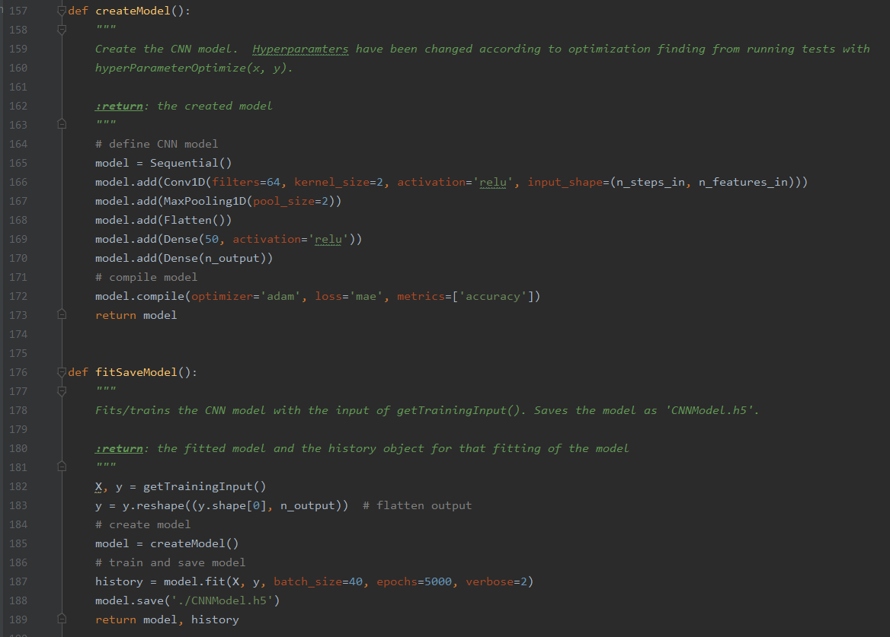
Final Solution (CNN) Code
Hyperparameters Optimized (Using GridSearchCV)
Batch size and epochs (40, 5000)
Optimizers (ADAM)
Activations functions (RELU)
Neurons in hidden layer (50)
Loss functions (MAE)
Timestep size Optimized (10). Meaning the model outputs 10 days of future data. Specific to the input data.

Slide 12
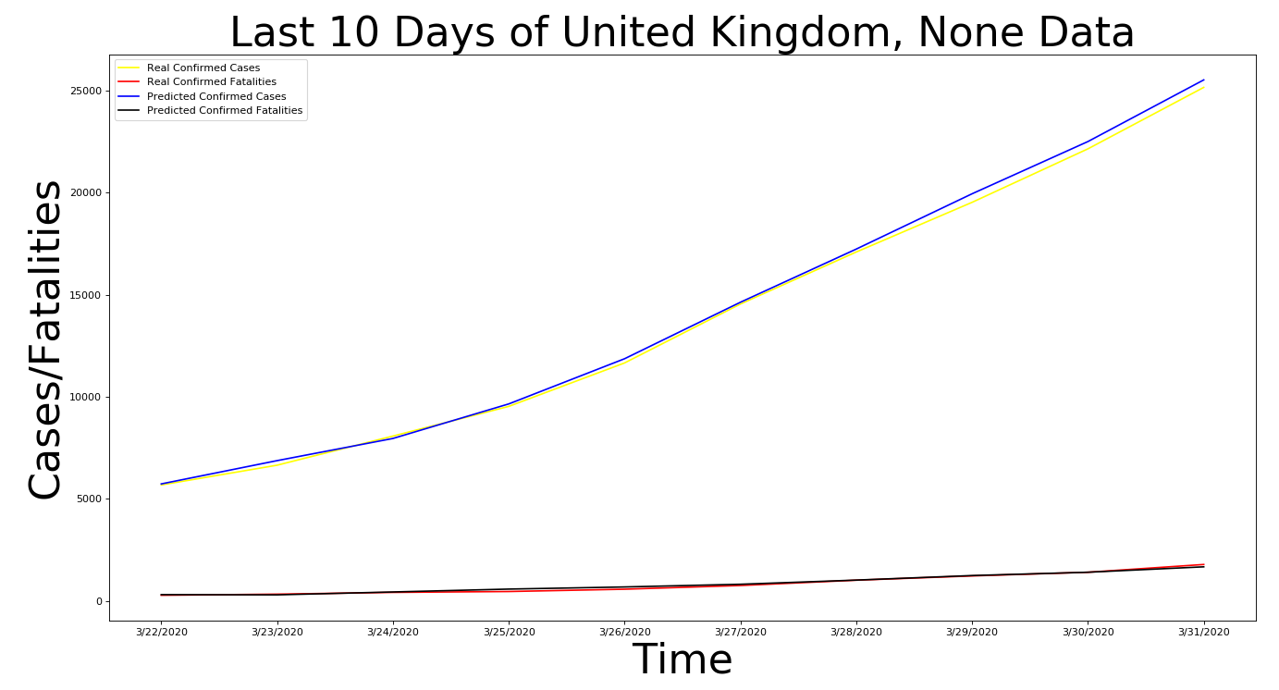
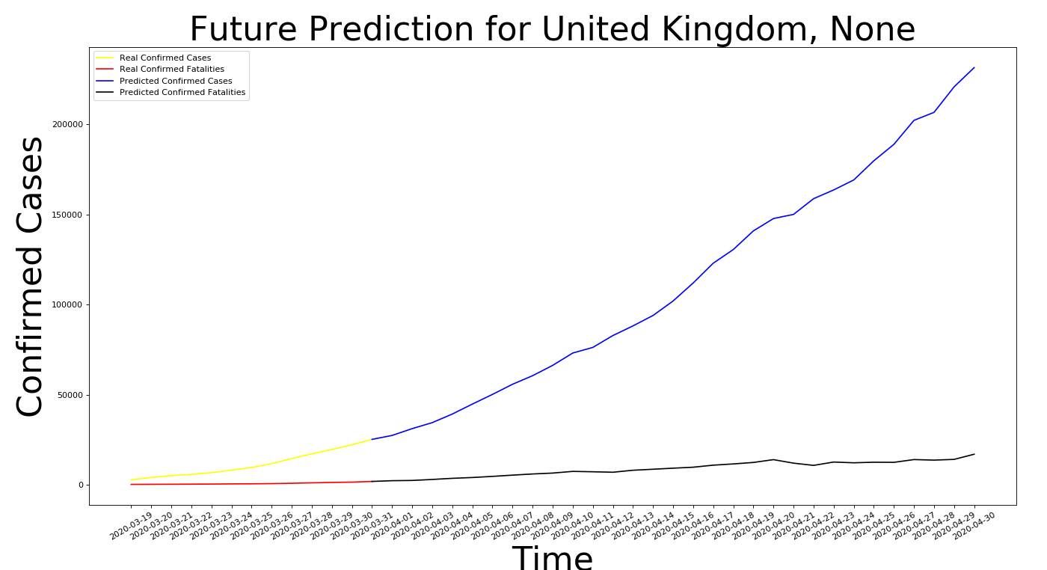
Results Sample (United Kingdom)

Slide 13
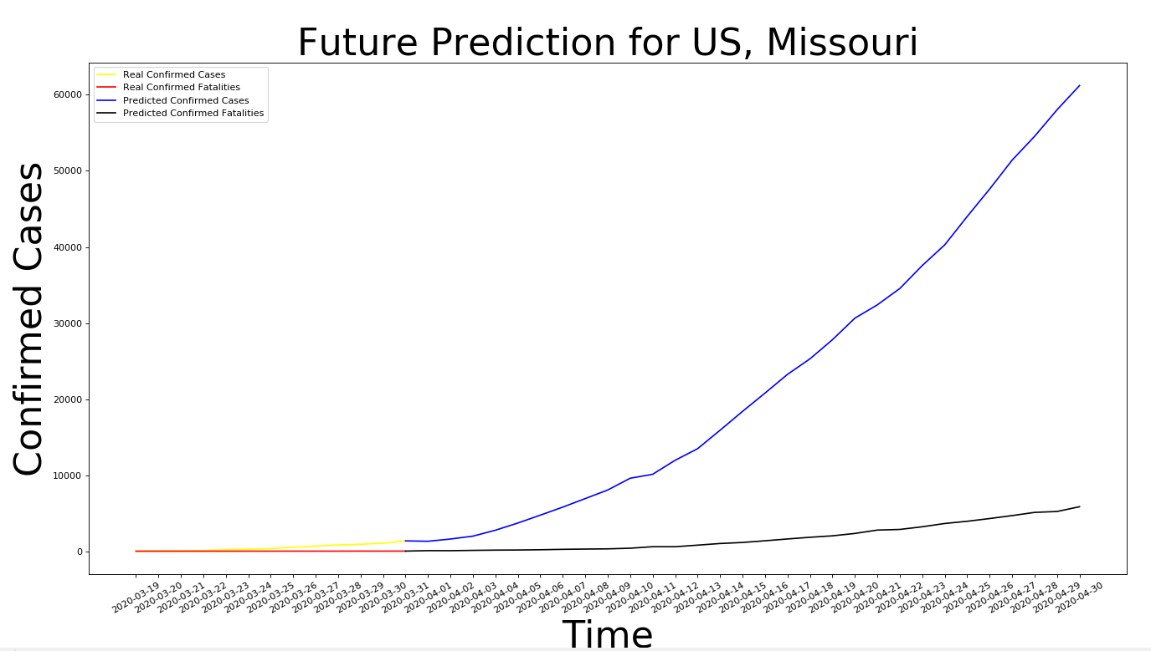
Results Sample (Missouri, US)
How it could be better:
More data (not far enough along).
Adjusting weight of certain data (Lockdown).
LSTM over CNN.
Scale data to Population.

Slide 14
Conclusion/Future Changes
Implementation of a proper LSTM or CNN-LSTM to see capability.
Scaling of Confirmed Cases and Fatalities data based on total population.
Continue adding newly found data.

